Slide 1
Neural variability in ASD
Quick sketch of current work
Presentation for Nam Wook Kim, August 12, 2021

Slide 2

Team
Aidas Aglinskas, Postdoc
Stefano Anzellotti, Prof.
Joshua Hartshorne, Prof.
Simons foundation grant

Slide 3
Problem setting
Autism is a debilitating disorder
Social, Behavioral impairments
Diagnosed behaviorally (DSM-IV, ADOS)
Extremely heterogenous
Symptoms differ
Abilities differ
Genetics
Response to treatment differs

Slide 4
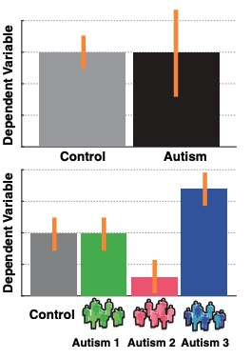
Problem setting
Autism is a debilitating disorder
Social, Behavioral impairments
Diagnosed behaviorally (DSM-IV, ADOS)
Extremely heterogenous
Symptoms differ
Abilities differ
Genetics
Response to treatment differs

Slide 5
Problem setting
Autism is a debilitating disorder
Social, Behavioral impairments
Diagnosed behaviorally (DSM-IV, ADOS)
Extremely heterogenous
Symptoms differ
Abilities differ
Genetics
Response to treatment differs
Lombardo, Lai & Baron-Cohen 2019

Slide 6
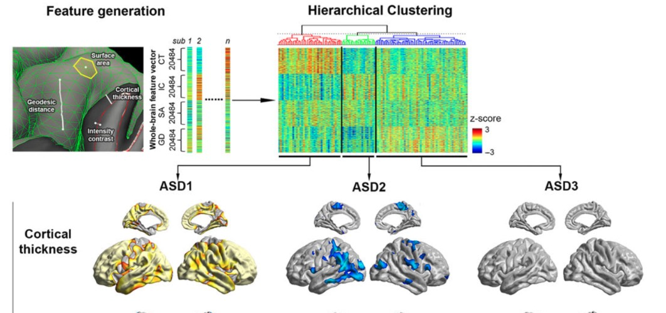
Neural Bases of ASD
“Common” abnormalities might not exist
Structured variability (”subtypes”) might.
Challenges:
Data dimensionality
Confounding variability due to
Data-acquisition confounds
ASD unrelated variability
Hong et al., 2018

Slide 7
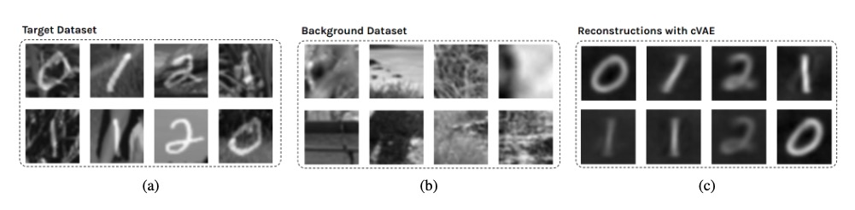
Contrastive learning
Abib, Zhou (2019)

Slide 8
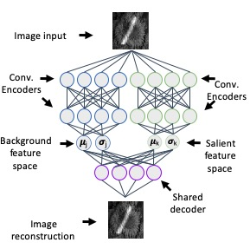
Contrastive learning
Abib, Zhou (2019)

Slide 9
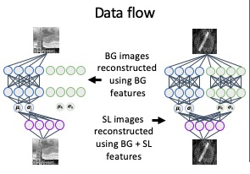
Contrastive learning
Abib, Zhou (2019)

Slide 10
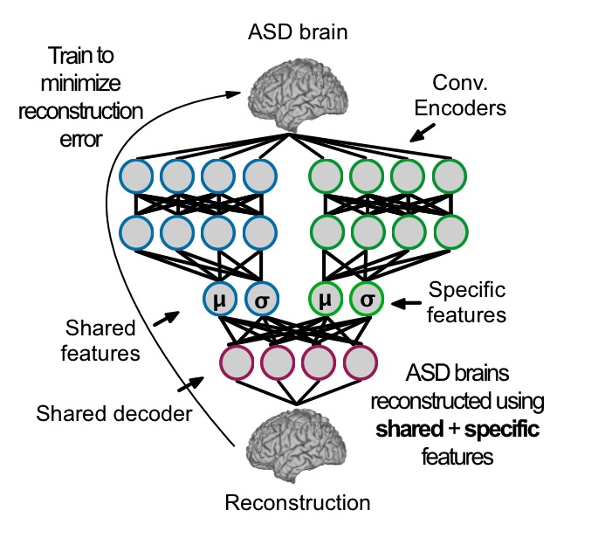
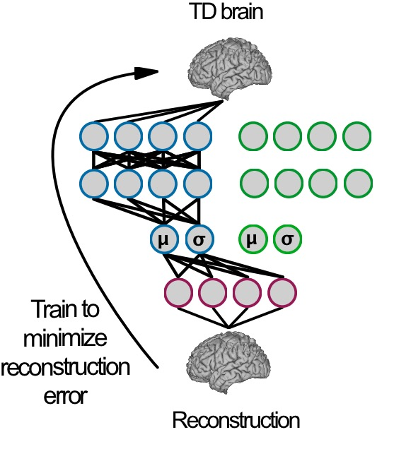
Approach
Key questions:
Relationship to symptoms
Subtypes
Neuroanatomy of ASD

Slide 11
Association with ASD symptoms
Representational similarity analysis (RSA)

Slide 12
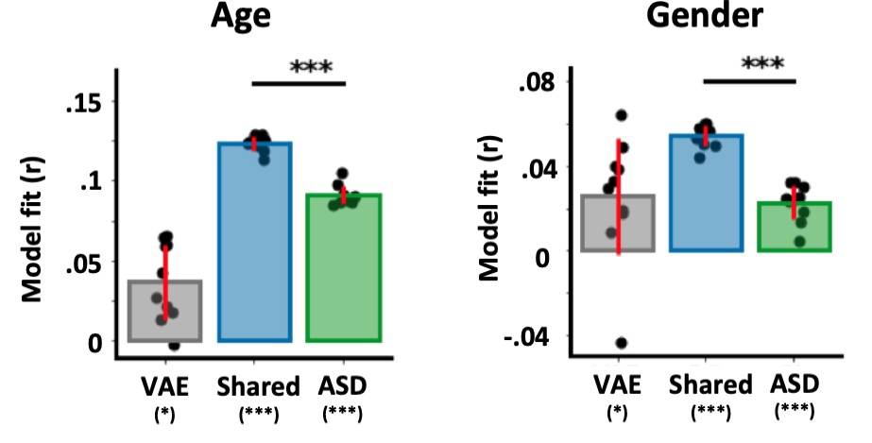
Association with ASD symptoms
Representational similarity analysis (RSA)

Slide 13
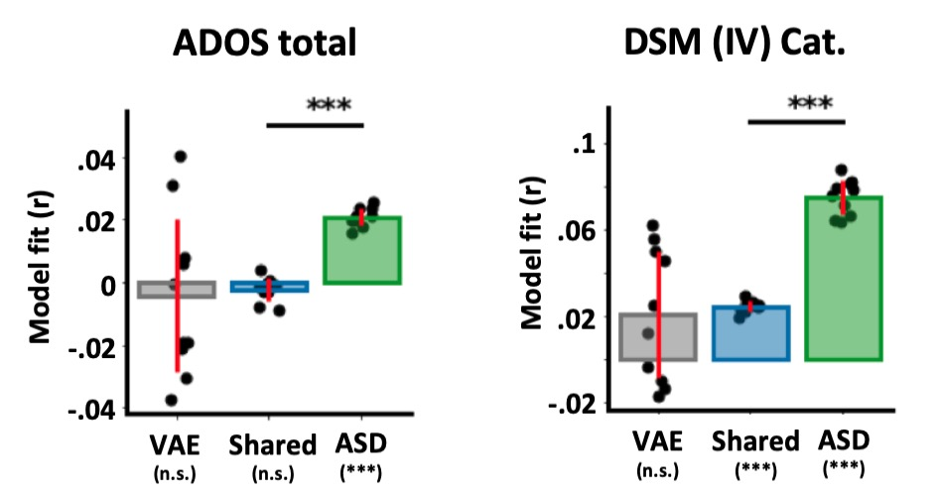
Association with ASD symptoms
Representational similarity analysis (RSA)

Slide 14
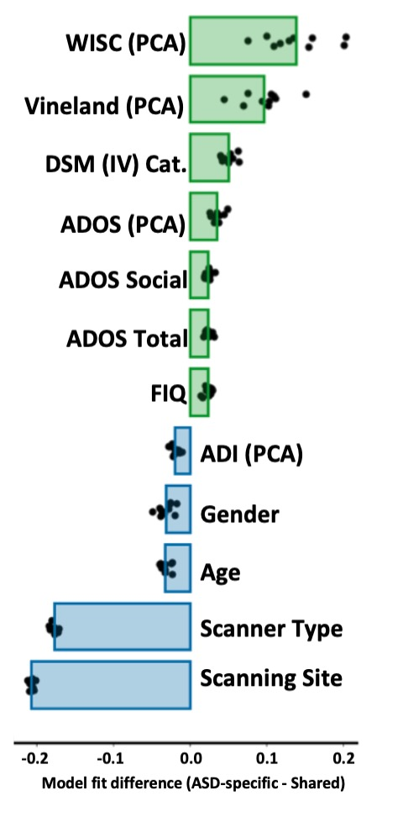
Association with ASD symptoms
Representational similarity analysis (RSA)

Slide 15
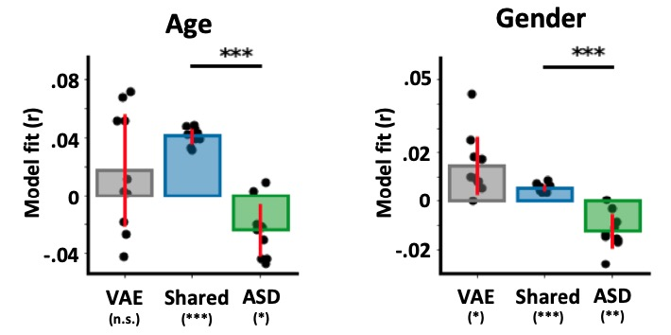
Association with ASD symptoms
Replication to an independent dataset

Slide 16
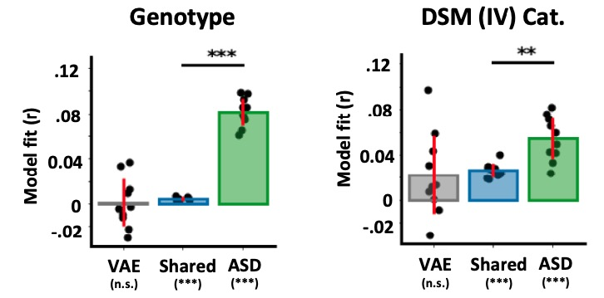
Association with ASD symptoms
Replication to an independent dataset

Slide 17
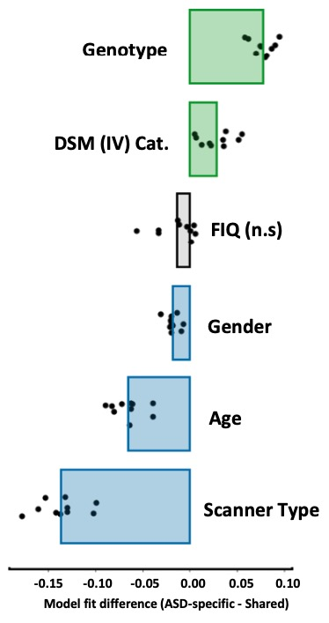
Association with ASD symptoms
Replication to an independent dataset

Slide 18
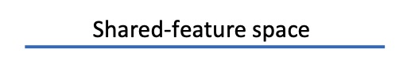
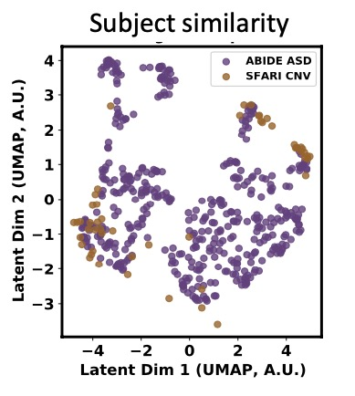
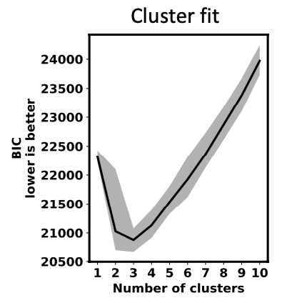
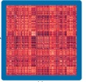
Structure of ASD
Shared neuroanatomy
Three clusters in shared space
UMAP

Slide 19
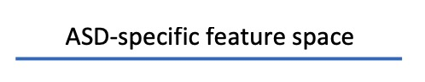
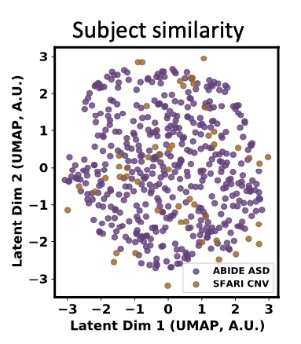
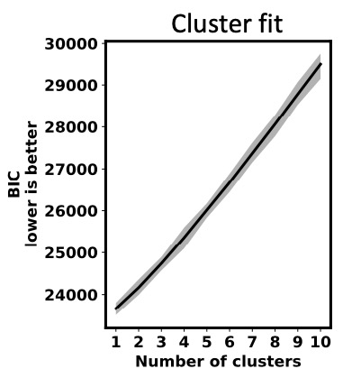
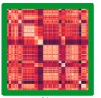
Structure of ASD
Shared neuroanatomy
Three clusters in shared space
No clusters in ASD-specific space
UMAP
ASD-specific neuroanatomy
UMAP

Slide 20
Counterfactual Neuroanatomy
What are the neural loci of variability in ASD?
Comparing TD and ASD includes differences not due to ASD
Comparing ASD vs synthetic ”TD twin”

Slide 21
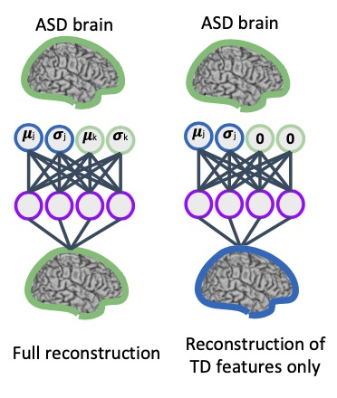
Counterfactual Neuroanatomy

Slide 22
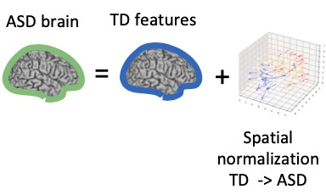
Counterfactual Neuroanatomy

Slide 23
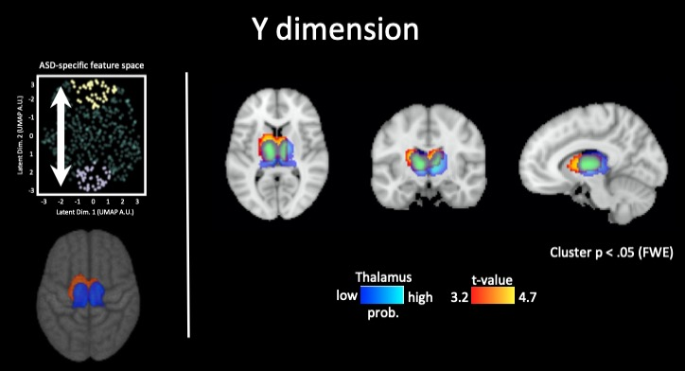
Neuroanatomical variability in ASD

Slide 24
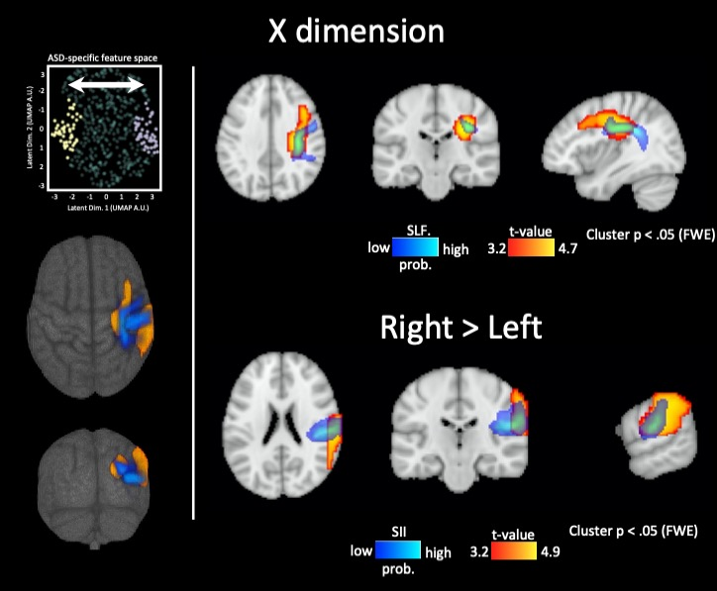
Neuroanatomical variability in ASD

Slide 25
Our problem
How to communicate the results via figures?
Disentangling of shared vs ASD-specific variability
Relationships with symptoms (RSA)
Counterfactual neuroanatomy

